Slide 1
미리가는 연구실 5일차
2024. 07.26

Slide 2
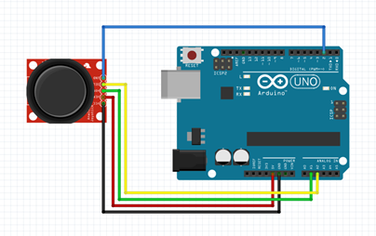
조이스틱 연결

Slide 3
소스코드
void setup()
{
pinMode(2,INPUT_PULLUP);
pinMode(A1,INPUT);
pinMode(A2,INPUT);
Serial.begin(9600);
}
void loop()
{
int x=analogRead(A1);
int y=analogRead(A2);
int sw=digitalRead(2);
Serial.print("switch ");
Serial.print(sw);
Serial.print(" X축 ");
Serial.print(x);
Serial.print(" Y축 ");
Serial.println(y);
}

Slide 4
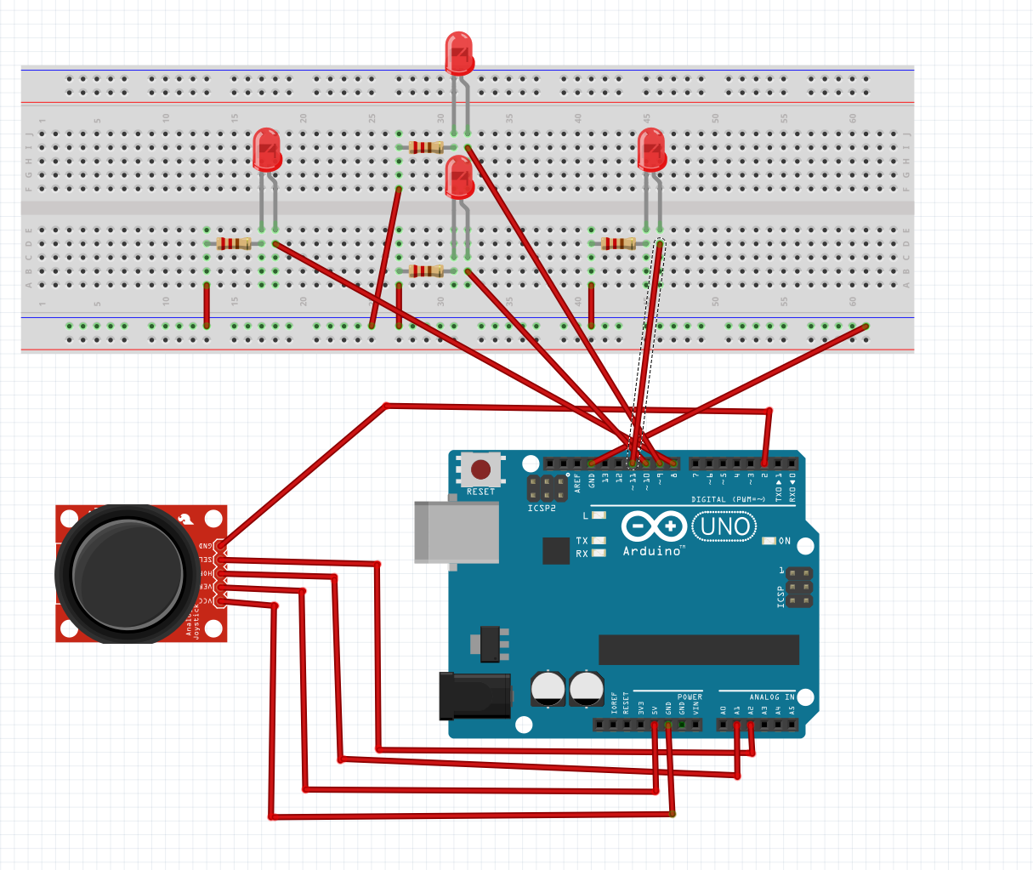
조이스틱 led 제어

Slide 5
소스코드
void setup()
{
pinMode(2,INPUT_PULLUP);
pinMode(A1,INPUT);
pinMode(A2,INPUT);
pinMode(8,OUTPUT);
pinMode(9,OUTPUT);
pinMode(10,OUTPUT);
pinMode(11,OUTPUT);
Serial.begin(9600);
}
void loop()
{
int x=analogRead(A1);
int y=analogRead(A2);
int sw=digitalRead(2);
if(x<300)
{
digitalWrite(8,HIGH);
}
if(x>700)
{
digitalWrite(11,HIGH);
}
if(y<300)
{
digitalWrite(9,HIGH);
}
if(y>700)
{
digitalWrite(10,HIGH);
}
if(sw==0)
{
digitalWrite(8,HIGH);
digitalWrite(9,HIGH);
digitalWrite(10,HIGH);
digitalWrite(11,HIGH);
}
digitalWrite(8,LOW);
digitalWrite(9,LOW);
digitalWrite(10,LOW);
digitalWrite(11,LOW);
}

Slide 6
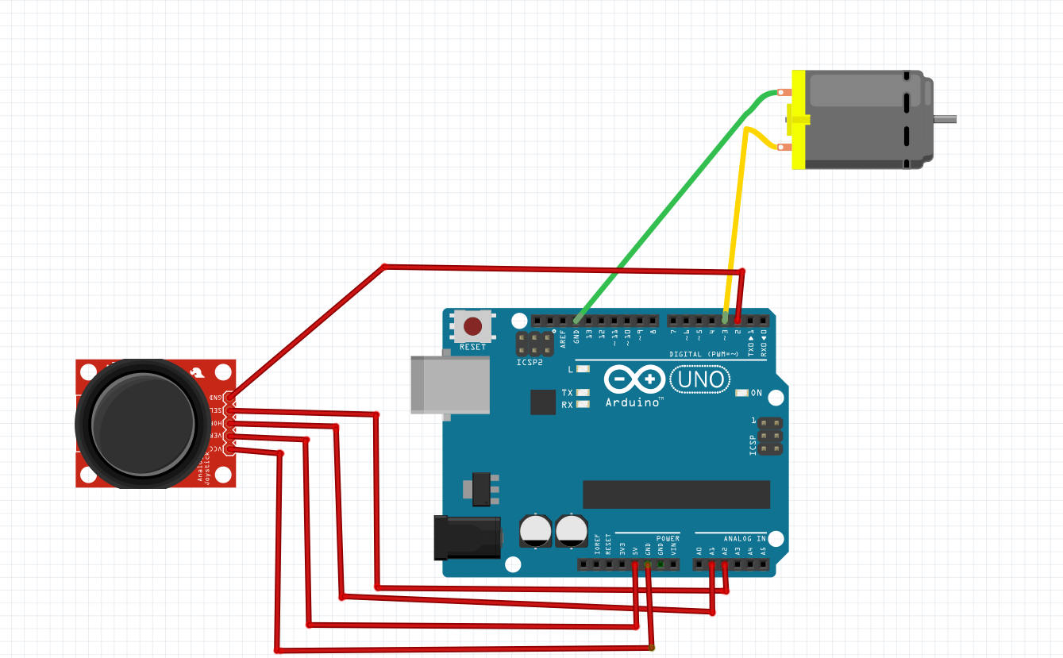
조이스틱 모터제어

Slide 7
소스코드
void loop()
{
int x=analogRead(A1);
int y=analogRead(A2);
int sw=digitalRead(2);
if(on==1)
{
if(y<300)
{
speed++;
if(speed<1024)
{
speed=1024;
}
}
if(y>700)
{
speed--;
if(speed<1)
{
speed=1;
}
}
analogWrite(A3,speed);
}
if(sw==0)
{
if(on==0)
{
on=1;
}
else
{
on=0;
analogWrite(A3,0);
}
delay(200);
}
}
int speed=0;
int on=0;
void setup()
{
pinMode(2,INPUT_PULLUP);
pinMode(A1,INPUT);
pinMode(A2,INPUT);
pinMode(A3,OUTPUT);
}

